Slide 1


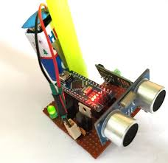
.
SMART BLIND STICK
PRESENTED BY:
SEVENTHEESH T

Slide 2
Objectives of the Project
Our objective is to make a smart blind stick with alerting ability and connected with the IOT to help blind people or guide them while they are navigating.
And we also designed a GPS tracking system with help of the IOT and it is paired with the blind stick.

Slide 3
.
S.no | NAME OF THE PAPER | ADVANTAGES | DISADVANTAGE
1. | Smart Blind Stick For Visually Impaired People With Live Monitoring | Usage of GPS and GSM module gives good accuracy | No sensors for detecting the fall down or and no sensor for detecting moisture and water.
2. | Smart walking stick for blind person | Different sensors have been used and most of the sensors have been covered. | Usage of different vibrational pattern for different direction are confusable
3. | An Intelligent Walking Stick for the Visually-Impaired People | It has the Bluetooth module for giving voice command gives more usability | Emergency alert buttons and GPS module has not been used and blue tooth module consume more power.

Slide 4
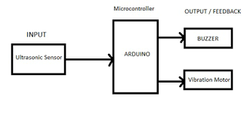
Existing System Architecture

Slide 5
Module in the project:
Module 1- sensing module.
Module 2- processing module.
Module 3- GPS module.
Module 4- GSM module with emergency button.

Slide 6
Summary of Module 1
Methodology used:
In ultrasonic sensor radar method used for detecting the obstacle.
In gyro sensor X-Y stability sensor has been used.
In water sensor water conduction method is used.

Slide 7
Summary of Module 2
Methodology Used:
Codes in C++ and Arduino programming has been used for processing the data given by the sensors.
The data from the ultrasonic sensor’s and water sensor’s have been received in analog and digital format it is decoded and processed by the Arduino by the c codes.

Slide 8
Summary of Module 2
It is the processing module where the whole inputs are read and the processed outputs are send to the particular output unit to give guidance to the blind person.
It is implemented with help of Arduino software to perform required action.

Slide 9
Summary of module 3
This GPS module is used to track the position of the blind person that is it is used to find the particular latitude and longtitude of the blind person and where he is locating and it the information is transferred to the particular care taker with the help of GSM module

Slide 10
Advantages of GPS:
GPS works altogether weather so you would like to not worry of climate as in other navigating devices.
GPS are often used anywhere within world, it’s powered by world satellites, so it are often accessed anywhere, a solid tracking system and a GPS receiver are all you would like.

Slide 11
Disadvantages of GPS:
GPS are often used anywhere within world, it’s powered by world satellites, so it are often accessed anywhere, a solid tracking system and a GPS receiver are all you would like.

Slide 12
Summary of Modules -4
GSM module is used to send or track alert message to have the connectivity with the particular phone or particular mobiles it is combined with the SIM for communication.
We added a emergency alert button to send the location of blind people to its care taker and to save them while they are in any danger

Slide 13
ADVANTAGES OF GSM MODULE:
It helps to have the connection.
It is cheap and best module for communication
DISADVANTAGE OF GSM MODULE:
It has many electrical it should correctly covered and it uses pulse base transmission so it is not allowed in petrol bunks and aeroplanes.

Slide 14
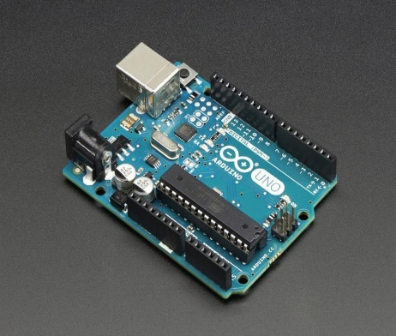
Software & Hardware Requirements Specification
Software Requirements:
Arduino IDE tool.
Hardware Requirements:
Ultra sonic sensor
Gyro sensor
Moisture senor
Arduino uno
GPS and GSM module.
Buzzer.

Slide 15
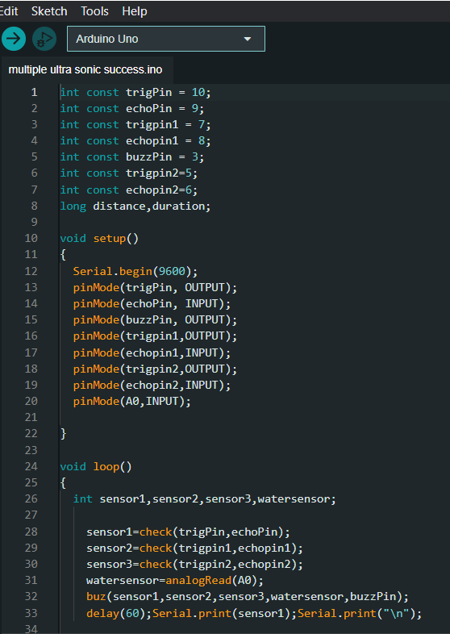
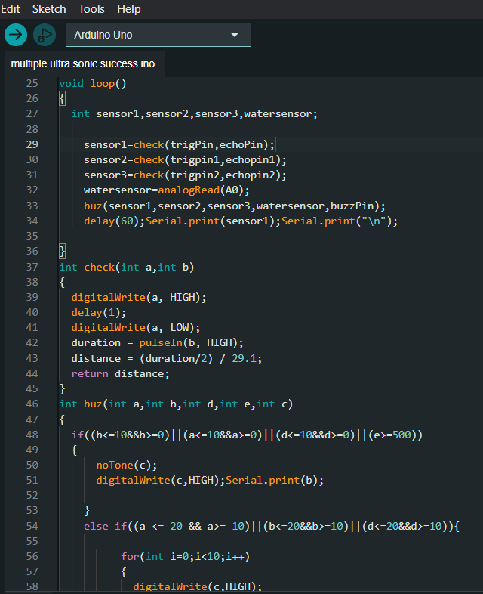
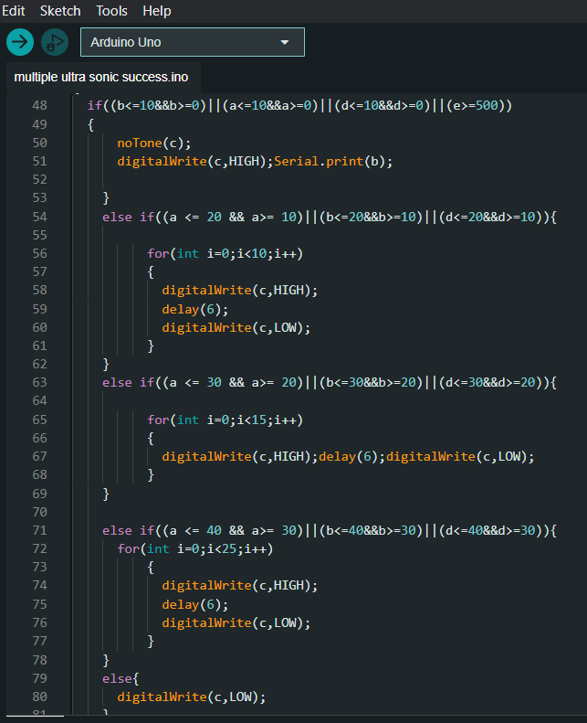
Partial Implementation of Modules

Slide 16
THANK YOU..

